Slide 1
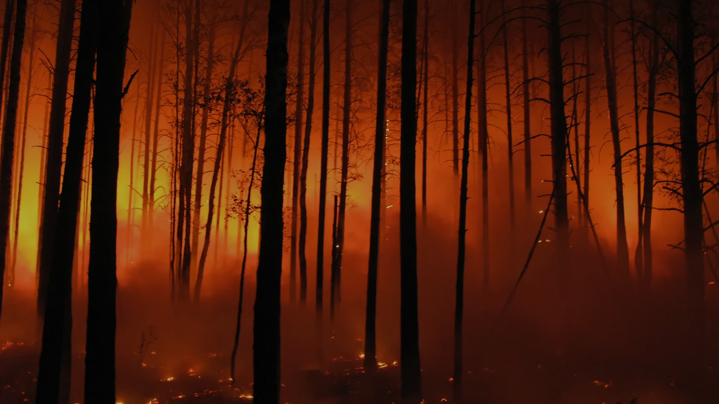
The Approach for Predicting wildfire incidents in Forested Environments
The Approach for Predicting wildfire incidents in Forested Environments
Project Guide:
M. Veerabrahmam
Dept of CBDS & AIML
Project Team Members:
Vemula Roshini Y20ADS430
Lella Ujwala Y20ADS412
Podapati Greeshma Sanjana Y20ADS423
Polineni VenkatRao L21ADS403
Presenter Name

Slide 2
Table of Contents:
Block diagram
System requirements
Algorithms
Applications
Detailed work plan
References
Conclusion
Abstract
Literature survey
Existing system
Disadvantages
Proposed system
Advantages

Slide 3



Abstract
Forest fires are the most destructive and devastating natural disasters. Forest fire prediction is done to lessen the impact of forest fires in the future. Current fire detection systems often lead to delayed responses, resulting in significant damage. In this study of forest environment, a fire information dataset from UCI(University of California Irvine) machine learning repository is taken for the experiment. The dataset includes physical and climatic factors of Algerian forest in Algeria. In this dataset, Meteorological factors such as temperature, rainfall, wind speed, and relative humidity are analyzed. The machine learning techniques such as Decision tree, Random Forest, Logistic Regression and various other algorithms are used to solve the fire prediction problem. By using advanced technique namely XGBoost, the dataset is trained to improve the overall performance. By doing this, our proposed system has obtained more accurate results in terms of accuracy, precision, and recall.

Slide 4
Literature Survey
In [2], forest fire prediction using machine learning techniques is suggested. The system procedures utilized meteorological factors to anticipate the chances of a wildfire and accustomed variation of under-sampling of the dataset which adapts many decision trees and employs aggregating to increase predicted performance and avoid over-fitting.
Predicting forest fire in Algeria using Machine learning techniques using a Ensemble model is investigated for predicting wildfires [3]. In terms of software development, the suggested DT-based wildfire predictive model attained an accuracy of around 98.36%.
Whereas, a GIS-based spatial prediction of tropical forest fire danger using a new hybrid machine learning method is investigated in Ref. [4].
Forest fire prediction using artificial neural network in Ref. [5] is carried out. Some of the factors such as temp, air humidity, and wind velocity are utilized by the researchers of this study to anticipate the likelihood of wildfires in Lebanon.
A number of other methods and models have been investigated for the prediction of forest and wildfires in last few years.

Slide 5
Existing System
There are so many fire detection algorithms available with many different approaches towards the detection of fire in the forest.
As per the existing work process, the fire affected part is predicted and analyzed based on the satellite images, another study is computer vision-based forest fire detection and monitoring system where fixed cameras are used (Toreyin et al., 2007) whereas in our proposed system meteorological parameters such as rain, temperature, wind and humidity were used to predict the occurrences of a forest fire.
There are many measures used to evaluate the performance of classifiers or predictors, such as the Gradient Boost Classifier, Vector Machine, Linear Regression and so on. Even though these methods are very helpful, they do have some disadvantages like some are sensitive to noisy data, complex, Overfitting and so on.
5

Slide 6
Disadvantages
Support Vector Machine (SVM)
Gradient Boosting Classifier
Random Forest Classifier
Scaling Sensitivity
Sensitivity to Outliers
Complexity and Interpretability
Not Suitable for Imbalanced Datasets
Prone to Overfitting
Interpretability

Slide 7
Proposed System
In our proposed system we use the Algerian dataset from UCI machine learning repository for the analysis. To detect and predict a precise prediction with high accuracy involves several key components, including data preprocessing, data splitting, feature selection, model selection, parameter tuning, and evaluation.
Hyperparameter tuning is the process of adjusting the parameters or hyperparameters of a machine learning model to optimize its performance. Parameters are the internal configurations of a model that are learned from training data, while hyperparameters are external configurations set before the training process. We also continuously monitored the model's performance and update it as needed to account for changing environmental conditions or patterns in the data it also plays a crucial role in optimizing machine learning models, especially when you have multiple hyperparameters to tune.

Slide 8
Proposed system architecture:
Dataset
Training set
Testing set
Random Forest
KNN
Logistic Regression
Output
XGBoost
Decision Tree

Slide 9
Advantages:
we eliminated the problems: overfitting, Instability, noisy data.
To ensure that features are on a similar scale and have equal importance during model training we used StandardScaler technique.
To improve overall performance, robustness, and generalization we used Advanced Technique called XG Boost.
We have improved the code to be easier to use and simpler in structure.
Finally, in comparison to the previous models our model got more accurate results.

Slide 10
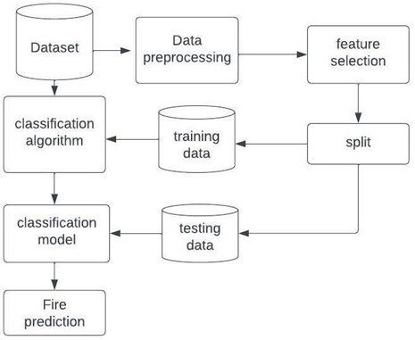
Block Diagram:
Visual representations of the forest fire prediction system, including data flow, model components, and real-time monitoring integration.

Slide 11


System Requirements:
Software Requirements:
Front End –Flask
Backend – Jupyter Notebook
Language – Python 3.10.7
Hardware Requirements:
Hard Disk: Greater than 500GB
RAM: Greater than 4GB
Processor: I5

Slide 12
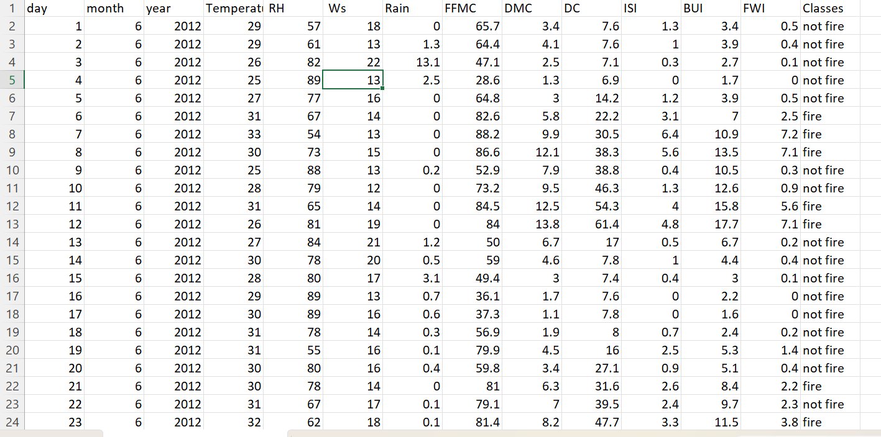
Dataset…

Slide 13
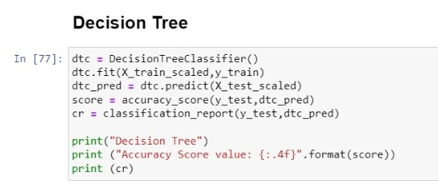
Algorithms:
Decision Tree: It is a supervised machine learning algorithm used for both classification and regression tasks. It works by recursively partitioning the dataset into subsets based on the features that best separate the target variable.

Slide 14
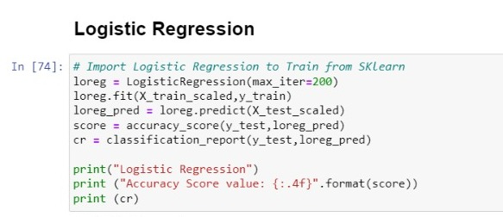
Logistic Regression : In the context of forest fire prediction, logistic regression can be employed to estimate the likelihood of a fire occurrence based on various environmental factors. The model outputs probabilities ranging from 0 to 1, where values closer to 1 indicate a higher likelihood of a forest fire, while values closer to 0 indicate a lower likelihood.

Slide 15
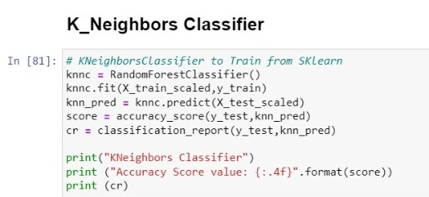
K_Neighbors Classifier: For forest fire prediction, KNN could utilize historical data on environmental conditions and fire occurrences to classify new instances as either "high risk" or "low risk" based on the similarity of their environmental features to past instances.

Slide 16
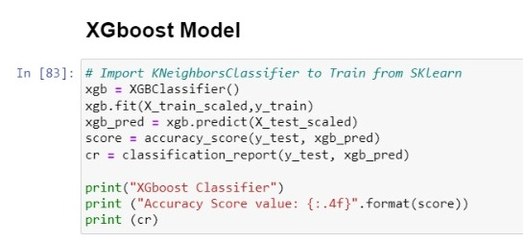
XGBoost : can analyze various features such as weather conditions, terrain, vegetation type, and human activity to predict the likelihood and severity of a forest fire. By learning from historical data, XGBoost can identify patterns and relationships between these features and the occurrence of forest fires, allowing it to make accurate predictions.

Slide 17
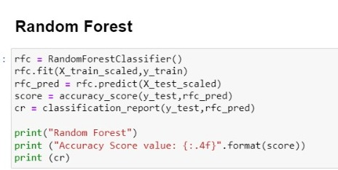
Random Forest : It can take various input features such as weather conditions, vegetation type, terrain characteristics, and historical fire data to predict the likelihood and extent of a forest fire. The model outputs a prediction indicating the probability or severity of a fire occurrence at a particular location and time.

Slide 18
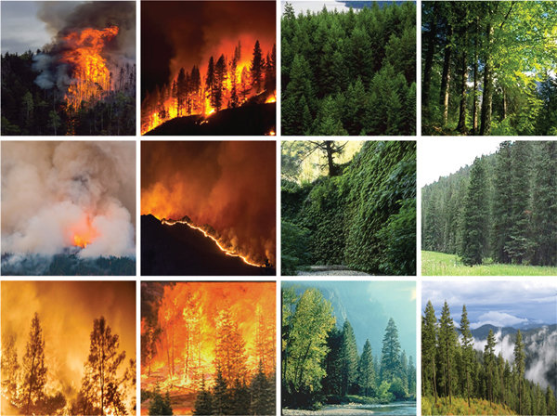


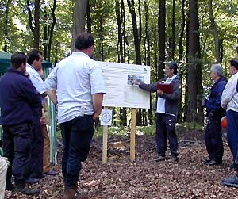
Applications:
Fire Behavior Prediction
Evacuation Planning
Environmental Impact Assessment
Public Awareness and Education

Slide 19
Work Plan:
Week | Work Done
Week1 | Search for the problem statement
Week2 | Understand basic terminology of problem
Week3 | Study of previous models
Week4 | Understanding the basic of machine learning algorithms and Ensemble models
Week5 | Dataset collection
Week6 | Developing code
Week7 | Developed code
Week8 | Enhancement of code
Week9 | Real world deployment
Week10 | Documentation

Slide 20
References:
Karouni, A. and et.al, “Applying decision tree algorithm and neural networks to predict forest” fires in Lebanon. J. Theor. Appl. Inf. Technol. 63(2), 282–291 (2014).
T. Preeti, and et.al, "Forest Fire Prediction Using Machine Learning Techniques," 2021 International Conference on Intelligent Technologies (CONIT), 2021, IEEE pp. 1-6.
Abid, F., Izeboudjen, N. (2020). “Predicting Forest Fire in Algeria Using Data Mining Techniques: Case Study of the Decision Tree Algorithm.” In: Ezziyyani, M. (eds) Advanced Intelligent Systems for Sustainable Development (AI2SD’2019). AI2SD 2019. Advances in Intelligent Systems and Computing, vol 1105. Springer, Cham.
Dieu Tien Bui, Hung Van Le, Nhat-Duc Hoang,(2018) ”GIS-based spatial prediction of tropical forest fire danger using a new hybrid machine learning method,” Ecological Informatics.
Ananthi, J & Sengottaiyan, N & Anbukaruppusamy, S & Upreti, Kamal & Dubey, Animesh. (2022). Forest fire prediction using IoT and deep learning.

Slide 21
Conclusion:
In conclusion, this project aimed to develop an effective forest fire through utilizing various data sources including weather conditions, topographical features, and historical fire data, we constructed a predictive model capable of forecasting the likelihood and severity of forest fires in a given area.
The results obtained from our model demonstrated promising accuracy and reliability in predicting forest fire occurrences. By leveraging advanced machine learning algorithms such as Random Forest, Support Vector Machines, we were able to identify significant predictors and patterns associated with forest fire outbreaks.
However, it's essential to acknowledge the limitations of our approach, including the inherent uncertainties in predicting complex natural phenomena such as forest fires. Factors such as human activity, sudden changes in weather patterns, and the dynamic nature of ecosystems may influence the accuracy of our predictions. Therefore, ongoing research and collaboration with domain experts are necessary to refine and improve the performance of our predictive model over time.

Slide 22

Please feel free to raise any queries.

